Slide 1
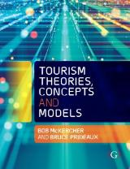

Chapter 4: Attractions

Slide 2
Learning Objectives
Conceptualise an attraction
Critique the tourism attraction system and identify and apply markers
Understand the hierarchy of attractions and recognise that the same attraction can play different roles for different market segments
Analyse a taxonomy of attractions
Apply the tourism attractions taxonomy in real world situations

Slide 3
Attractions and Access drive tourism
Tourism is driven by attractions and access.
Attractions explain why people come to a destination, while access influences the volume of visitors.
Attractions act as demand generators that give the customer a reason to visit.
Consumption of attractions is often considered to be the central theme of the tourism experience being offered.
Goeldner and Ritchie (2012) argue that attractions drive people to travel and represent the main motivations for travel.

Slide 4
Attractions play 3 roles in tourism
An intrinsic part of the trip, in which the demand for the attraction is established before the trip commences
Major motivator for a trip or for selecting a destination
Optional, discretionary activity engaged in at a destination

Slide 5
But…
Attractions are quite misunderstood
No universally accepted definition of attractions exists
Term has been misused, with the concept of what constitutes varying levels of attractions and activities conflated and confused.

Slide 6
Attractions initially conceptualised from a supply side
An attraction consists of a single entity bounded by time or space that is visited by tourists.
Pearce (1991) "a named site with a specific human or natural feature which is the focus of visitor and management attention."
Lew (1987), suggests attractions consist of all those elements of a "non home" place that draw discretionary travellers away from their homes.
Three features to consider:
  If no tourists visit, then it cannot be called a tourist attraction
  Their narrow geographic or temporal focus means that a region or an extended environment is not considered as a single, holistic attraction
  Can activities be considered as attractions or are they distinct?

Slide 7
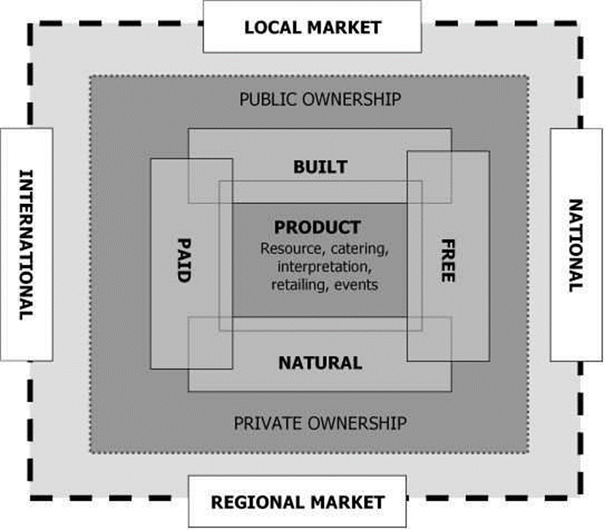
Leask (2008) conceptualisation
Progressive model
  Begins with the resource in question, interpretation, events and augmented services provided.
  Then structural issues, whether it is natural or built and whether admission is free or has a charge attached to it.
  Ownership structure follows, with two broad types of public or private ownership.
  Finally scale of market appeal

Slide 8
Conceptualising attractions from a demand side perspective
Tourism products exist to satisfy the needs of tourists and for no other reason
UNWTO (2008) states attractions are defined as much by the activities pursued by visitors as by the supplier, meaning that almost anything could be considered as an ‘attraction’ if it is used by tourists
Implications:
  Expands the idea of what constitutes an attraction
  Attractions can include non-location specific experiences or activities
  The definition acknowledges that attractions do not have to be commercial or managed, in recognition that much of what tourists consume is part of the public domain, available free of charge
  Eliminates scale and spatial considerations as defining variables

Slide 9
Traditional hierarchy
Primary attractions
  Give the traveller a reason to visit an area
  Often help create or frame the image of the destination
Secondary attractions
  Have regional appeal
  Do not drive trip but people will want to see them
Tertiary attractions
  Convenience based
  Complement the trip but do not drive visitation

Slide 10
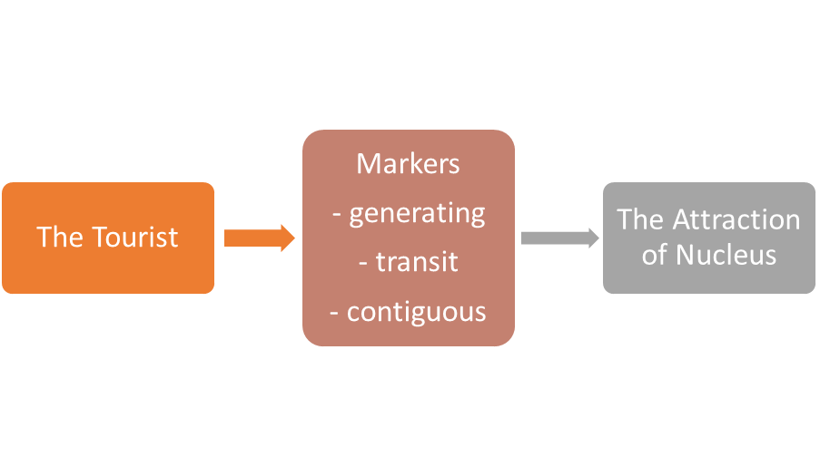
Tourist attractions system (Leiper 1990)
The tourist – search for satisfying leisure experiences
Nucleus - any feature or characteristic of a place that a traveler contemplates visiting or actually visits
Markers - catalytic link between the tourist and the attraction that triggers motivation
  Any kind of information or representation that constitutes an attraction as a tourist site by giving information about it, representing it, making it recognizable

Slide 11
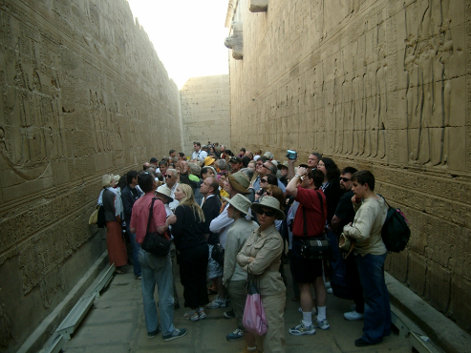
Markers are the most important part of the tourist attractions system
Markers create awareness
Stimulate the tourists’ desire to look for experiences
Contain information or present an image about what might be experienced at the sights targeted.
3 types
  In-destination
  In-transit
  In-generating region
Photograph by McKercher

Slide 12
Rethinking attractions as operating as part of a taxonomy
The term ‘attraction’ is used so loosely now that its meaning can include anything that tourists may consume from a specific product to an entire category of products or activities that encompasses but extends well beyond the specific.
Example
  An historic site is classified as an attraction
  Heritage, consisting of many historic sites, archeological sites and historic landmarks is also an ‘attraction’
  Cultural heritage consisting of heritage and culture is also considered an attraction
Moving from the specific the general, then, the set of attractions, activities and entities that can be included grows exponentially.
Conversely, as one moves from the general to specific what constitutes an attraction is more clearly defined
Culture heritage
Heritage
Historic site
Historic site
Culture
Intangible heritage

Slide 13
Taxonomic systems
A hierarchical classification system to indicate natural relationships between items at different levels
Classify items using observable and measurable characteristics
Based on the idea of a natural classification, where members of each tier of a taxonomy are on the average more similar to each other than they are to members of other taxa at corresponding levels
Homogenous groups are formed with reasonably sharp boundaries
Taxa are arranged vertically to reflect increasing specificity, with the top tier encompassing a broad comprehensive category that captures the essence of all groups and subgroups that fall under it
Lower-level tiers are disaggregated into one or more narrower cohorts, until one reaches the bottom where individual entities are found

Slide 14
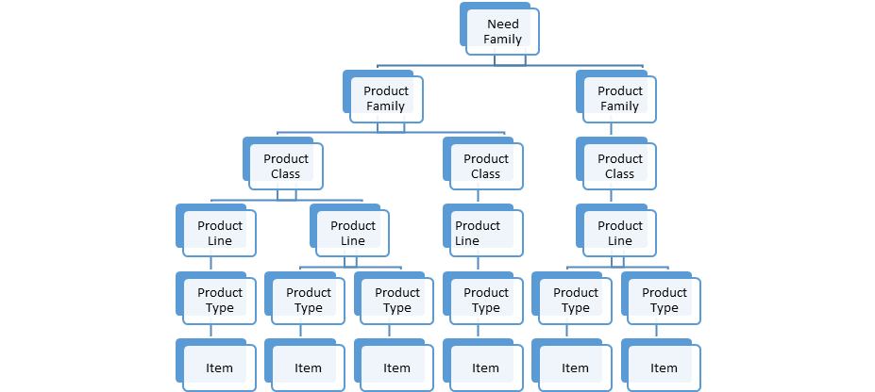
Taxonomy of attractions
Adopting Kotler’s idea of a product taxonomy
Attractions may be seen to exist in a hierarchical form from the specific site at the bottom to sets of like attractions, to sets of similar attractions, to sets of thematically related attractions, and so on.
The set of thematically similar attractions and attractions sets increases significantly as one moves up the classification system, and likewise decreases significantly until reaching a single item as one moves down the system.
Source: Kotler 2012

Slide 15
Tourism product taxonomy
6 tier taxonomy proposed
  Need Families – Pleasure, Personal Quest, Human Endeavour, Nature and Business.
  Product Family as subset of need families
  Product Class as subset of product families
  Product Line as subset of product class
  Product Type as subset of product line
  Individual Items where consumption occurs
Source: McKercher 2016

Slide 16
Example of the first 2 tiers of the tourism product taxonomy
Pleasure
Meetings
Business
Personal Quest
Human Endeavour
Nature
Food and drink
Leisure
Indulgence
Etc.
Personal history
Religious
Wellness
Industrial
Built heritage
People and intangible heritage
Adventure
Consumptive
Water based
Conventions
Exhibitions

Slide 17
Applying the tourism attractions taxonomy - Do attractions attract tourists?
Do people come to a destination because of a specific attraction (Item level of the taxonomy) or because of a collection of like attractions (i.e. shopping or dining) (higher order taxa), where the individual attraction plays little or no role in the visit decision?
What is the proximate cause (or sine qua non – if not for)?
  If not for this attraction or set of attractions you would not have visited
  Sine qua non distinguishes the difference between what people do in a destination and why they come

Slide 18
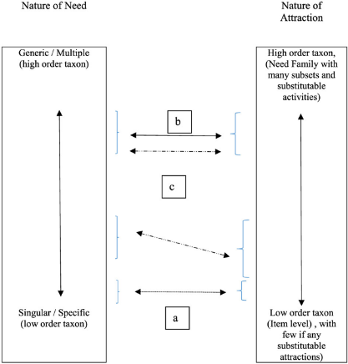
Matching needs to attractions
Tourists needs vary from the generic to the specific and usually include a variety of both
Depending on the need, different taxa play a role in the visit decision
Specific needs can only be satisfied by the type of specific product found at the base of the taxonomy
More generalist needs can be satisfied by attraction sets found at the higher order of the taxonomy

